Slide 1
Artificial Led Zeppelin
April 29, 2019
CS 582 Semester Project
Kaiyu Chen, Brian Rafferty, Richard Estes
CS 582
Notes:
Brian

Slide 2
What we did
We implemented a recurrent neural network that read in all of the lyrics written by Led Zeppelin and used it to generate artificial lyrics of our own.
Notes:
Kaiyu

Slide 3
The Challenge
Using a recurrent neural network to generate artificial lyrics was difficult for us to grasp in the beginning.
Why? None of us have ever used a neural network before tackling this problem, so we spent the beginning of the project researching the best ways to get the job done.
Once we got the theoretical side of things down, we then hit the brick wall of actually implementing it on a technical level.
We were utterly confused at where to start once we read in our lyrical data.
Luckily, we found a plethora of useful information online, including tutorials on initializing neural networks.
Notes:
Richard
Decided to use a RNN via PyTorch
Inputs produce a series of outputs, and is passed to the next cell as an input
RNNs are useful for a number of applications of data, but specifically series (such as Music composition, translation, and text generation)

Slide 4
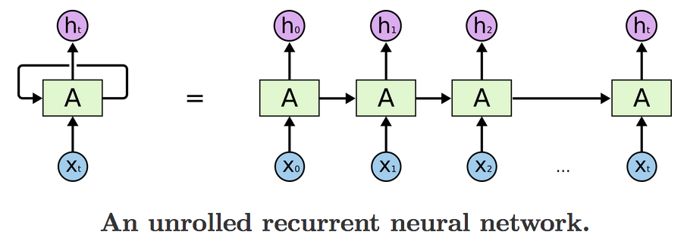
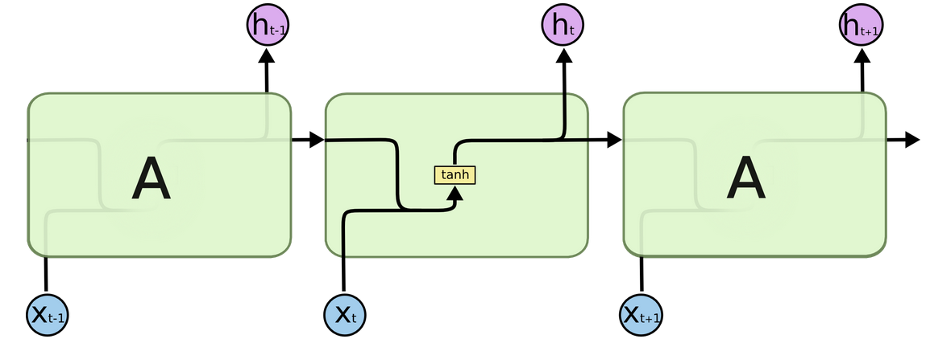
Concepts
Why use a recurrent neural network?
They have an ability to remember past information in order to process new information by looping in on themselves. This loop is known as the hidden state, and passes the output to the next node for future use.
Key points of how recurrent neural networks function:
Think of RNNs as systematic voting machines, that know which elements to cast a vote for based upon prior input
RNNs can base decisions on things that happened in the past due to Late Short-Term Memory (LSTM) cells they contain
LSTMs provide an algorithmic approach to what should be remembered and what should be forgotten over the duration of training
Notes:
Brian

Slide 5
Example of how they work:
Sample Sentence:
Jake saw Mike.
If the RNN receives “saw”:
Forms rules:
A name (Jake, Mike) can be followed by saw or a period.
Saw can be followed by a name, but not the name that came before it.
Check to see which name came before
Cast negative vote for that name
Cast positive vote for name it has not seen.
The input with the highest votes will be sent through as output.
Notes:
Brian

Slide 6
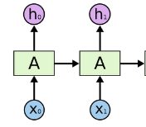
Example that mimics our model:
Put individual characters into RNN:
‘h’,’e’,’l’,’l’,’o’
e
l
l
o
RNN begins by encoding each letter
h = [1,0,0,0]
e = [0,1,0,0]
l = [0,0,1,0]
o = [0,0,0,1]
Continues by doing matrix multiplication to get desired letter as result during each step
Think of them as an input vector/target vector pair.
e
l
l
o
h
e
l
l
Notes:
Brian

Slide 7
Objective
We have the objective to analyze and synthesize speech data, so we decided to read in speech in the form of text and generate original text from it.
Objectives to get it done based upon original research:
Create dataset containing lyrics
Read in dataset and store characters into a set and dictionaries
Instantiate RNN using built in Python library PyTorch
PyTorch Includes LSTM which just needs our character set to create the model
Use those data structures to convert each character into a one-hot vector
Divide up one-hot vectors into manageable chunks and feed them into RNN iteratively
When value loss is low and RNN is trained, use saved model to synthesize our own lyrics
Notes:
Richard
Obviously we wanted to increment from synthesizing text to iteratively create something that resembled cohesive song lyrics.

Slide 8
Procedure / Methodology
Created separate program to function as a training method, to take in the character set and begin creating and encoding vectors based upon the dictionary key/value pairs.
Ex: If ‘a’ had int value 2, it would be [0,0,2,...]
Encoded ‘a’ vector would be: [0,0,1,0,...]
Method used one-hot vectors to instantiate input characters and target characters
Next, it would pass input vectors into the model using the RNN’s built in forward algorithm
Once the RNN had trained for several hours, the model was saved and was ready to be used to generate our artificial lyrics.
Lastly, created methods to use the model’s probabilities to predict and generate original lyrics
Plan A:
Scraped website: https://www.allthelyrics.com/lyrics/led_zeppelin, to get every lyric every written by Led Zeppelin. Compiled it into a large txt file.
Started Python program by opening the txt file and read in all the information.
Stored each character used into a set, and then used that set to create two dictionaries with key value pairs of (int/char) and (char/int)
Instantiated RNN using PyTorch’s built in NN class called Module which included LSTM model
Used character set to build LSTM model
Notes:
Brian

Slide 9
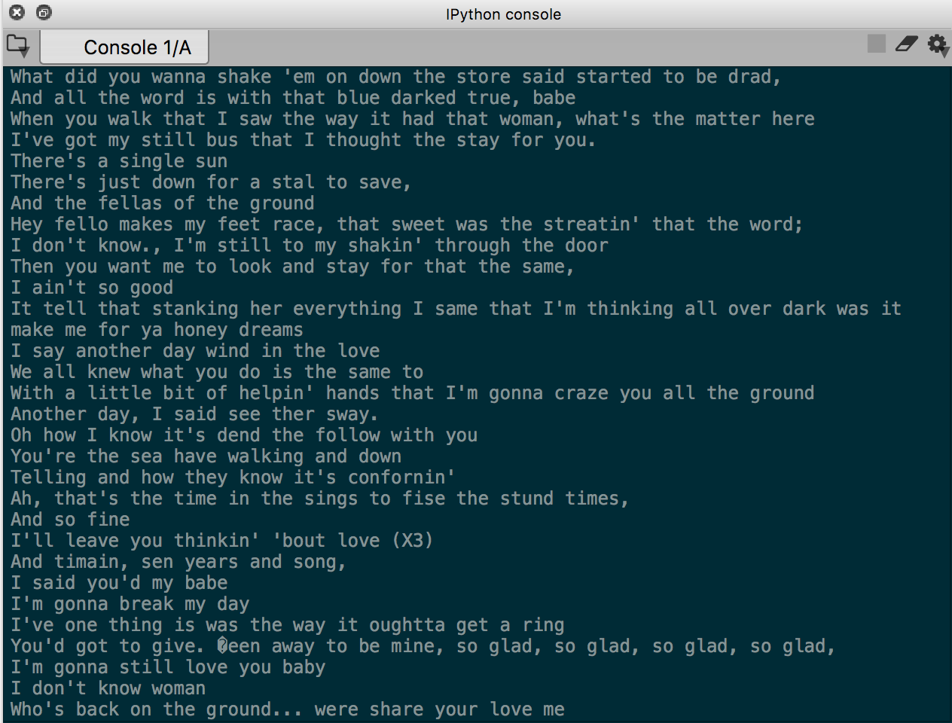
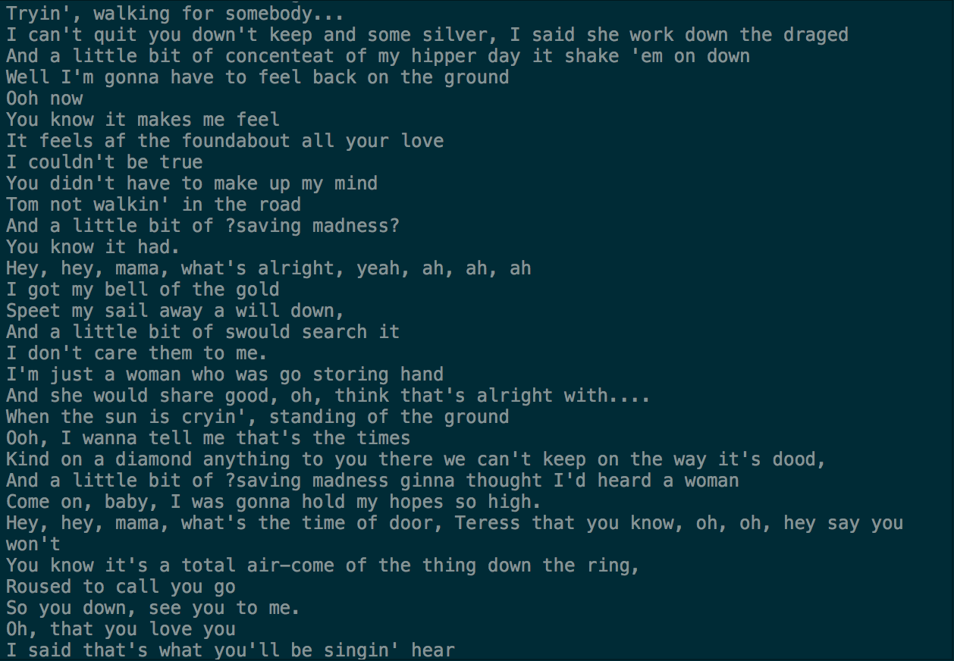
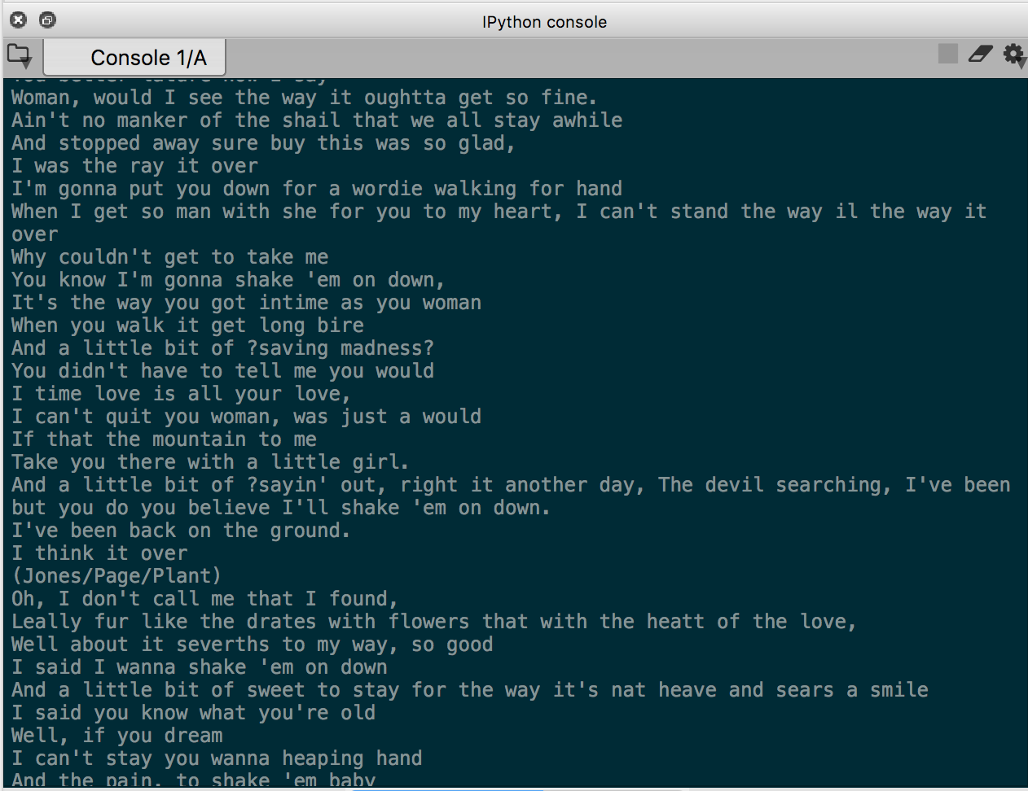
Results
Successfully read in all data from .txt file and pushed it through our recurrent neural network until it learned how to predict the next character accurately.
Here is some sample lyrics we generated with our RNN:
Notes:
Richard
Lyrics are almost intelligible english, so we’re not far off regular led zeppelin lyrics.
issue: the verses don’t necessarily rhyme. lack of musical structure (bridge, verse, chorus)

Slide 10
References
Lecture on RNN’s that was very helpful to our understanding
Kim, Sung. “PyTorch Lecture 12: RNN1 - Basics.” YouTube, YouTube, 27 Dec. 2017, www.youtube.com/watch?v=ogZi5oIo4fI.
Tutorial on recurrent neural network design/methodology
Lai, Albert. “Writing Like Shakespeare with Machine Learning in Pytorch.” Towards Data Science, Towards Data Science, 8 Feb. 2019, towardsdatascience.com/writing-like-shakespeare-with-machine-learning-in-pytorch-d77f851d910c
Led Zeppelin Lyrics
NA. “Led Zeppelin Lyrics.” Led Zeppelin Lyrics: 83 Song Lyrics, www.allthelyrics.com/lyrics/led_zeppelin.
Notes:
Kaiyu

Slide 11
Conclusion
We ran into many problems throughout the experience, due to our general lack of knowledge in the realm of neural networks. After we found resources online and began to grasp the scientific libraries contained in python, the project ran much smoother. We found that neural networks, although they sound intimidating, are actually quite intuitive and straightforward to implement if you know the right places to do your research.
Notes:
Kaiyu

Slide 12
Demonstration
If you want to see us do this...
Notes:
Brian

Slide 13
Thank you for listening! Have a wonderful afternoon!

